Slide 1
Unicast Routing
Dr. Hasan Humayun

Slide 2
20.1 INTRODUCTION
Unicast routing in the Internet, with a large number of routers and a huge number of hosts, can be done only by using hierarchical routing:
Using different routing algorithms.
Unicast routing in an internet:
An internetwork made of networks connected by routers.
After understanding the routing concepts and algorithms.
We show how we can apply them on RIP using hierarchical routing.

Slide 3
20.1.1 General Idea
In unicast routing, a packet is routed, hop by hop, from its source to its destination by the help of forwarding tables.
The source host needs no forwarding table because it delivers its packet to the default router in its local network.
The destination host needs no forwarding table either because it receives the packet from its default router in its local network.
This means that only the routers that glue together the networks in the internet need forwarding tables.
So, routing a packet from its source to its destination means routing the packet from a source default router to a destination router.
Although a packet needs to visit the source and the destination routers,
? The question is what other routers the packet should visit?
In other words, there are several routes that a packet can travel from the source to the destination;
What must be determined is which route the packet should take.

Slide 4
An Internet as a Graph
To find the best route, an internet can be modeled as a graph.
A graph is a set of nodes and edges (lines) that connect the nodes.
To model an internet as a graph, we can think of each router as a node and each network between a pair of routers as an edge.
An internet is, in fact, modeled as a weighted graph, in which each edge is associated with a cost.
If a weighted graph is used to represent a geographical area, the nodes can be cities and the edges can be roads connecting the cities; the weights, in this case, are distances between cities.
In routing, however, the cost of an edge has a different interpretation in different routing protocols
For the moment, we assume that there is a cost associated with each edge. If there is no edge between the nodes, the cost is infinity.

Slide 5
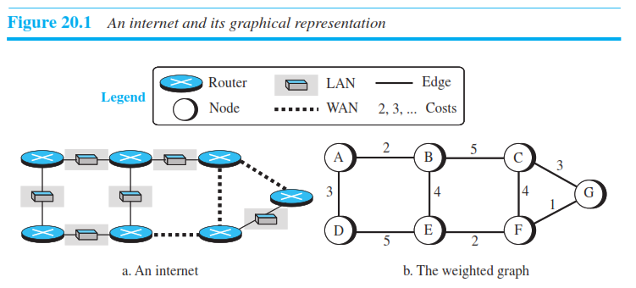
Figure 20.1 shows how an internet can be modeled as a graph.

Slide 6
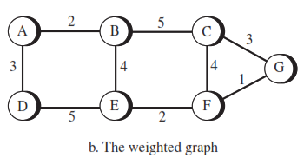
Least-Cost Routing
When an internet is modeled as a weighted graph, one of the ways to interpret the best route from the source router to the destination router is to find the least cost between the two.
In other words, the source router chooses a route to the destination router in such a way that the total cost for the route is the least cost among all possible routes.
In Figure 20.1, the best route between A and E is A-B-E, with the cost of 6.
This means that each router needs to find the least-cost route between itself and all the other routers to be able to route a packet using this criteria.

Slide 7
Least-Cost Trees
If there are N routers in an internet, there are (N - 1) least-cost paths from each router to any other router.
This means we need N × (N - 1) least-cost paths for the whole internet.
If we have only 10 routers in an internet, we need 90 least-cost paths.
A better way to see all of these paths is to combine them in a least-cost tree.
A least-cost tree is a tree with the source router as the root that spans the whole graph (visits all other nodes) and in which the path between the root and any other node is the shortest.
In this way, we can have only one shortest-path tree for each node; we have N least-cost trees for the whole internet.

Slide 8
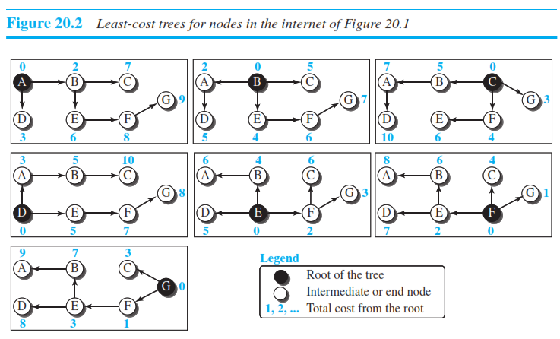
Least Cost Trees
Figure 20.2 shows the seven least-cost trees for the internet in Figure 20.1.

Slide 9
20.2 ROUTING ALGORITHMS
After discussing the general idea behind least-cost trees and the forwarding tables that can be made from them, now we concentrate on the routing algorithms.
Several routing algorithms have been designed in the past.
The differences between these methods are in the way they interpret the least cost and the way they create the least-cost tree for each node.
We shall discuss the common algorithms, and later see how a routing protocol in the Internet implements one of these algorithms, especially RIP.

Slide 10
20.2.1 Distance-Vector Routing
The distance-vector (DV) routing has the goal to find the best route.
In distance-vector routing, the first thing each node creates is its own least-cost tree with the rudimentary information it has about its immediate neighbors – directly connected Routers.
The incomplete trees are exchanged between immediate neighbors to make the trees more and more complete and to represent the whole internet.
We can say that in distance-vector routing, a router continuously tells all of its neighbors what it knows about the whole internet (although the knowledge can be incomplete).
Before we show how incomplete least-cost trees can be combined to make complete ones.
We need to discuss two important topics: the Bellman-Ford equation and the concept of distance vectors, which we cover next.

Slide 11
Bellman-Ford Equation
The heart of distance-vector routing is the famous Bellman-Ford equation.
This equation is used to find the least cost (shortest distance) between a source node, x, and a destination node, y
through some intermediary nodes (a, b, c, . . .)
when the costs between the source and the intermediary nodes and the least costs between the intermediary nodes and the destination are given.
In distance-vector routing, normally we want to update an existing least cost with a least cost through an intermediary node, such as z, if the latter is shorter.
We can say that the Bellman-Ford equation enables us to build a new least-cost path from previously established least-cost paths.
We will shortly show how we use the Bellman-Ford equation and the concept of distance vectors to build least-cost paths for each node in distance-vector routing, but first we need to discuss the concept of a distance vector.

Slide 12
Distance Vectors
The concept of a distance vector is the rationale for the name distance-vector routing.
A least-cost tree is a combination of least-cost paths from the root of the tree to all destinations.
These paths are graphically glued together to form the tree.
Distance-vector routing unglues these paths and creates a distance vector, a one-dimensional array to represent the tree.
Figure 20.4 shows the tree for node A in the internet in Figure 20.1 and the corresponding distance vector.
Note that the name of the distance vector defines the root, the indexes define the destinations, and the value of each cell defines the least cost from the root to the destination.

Slide 13
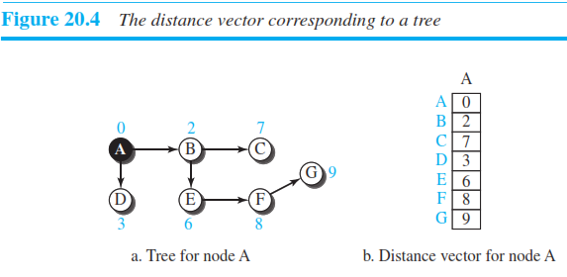

Slide 14
Distance Vectors Conti……
A distance vector does not give the path to the destinations as the least-cost tree does; it gives only the least costs to the destinations.
We can change a distance vector to a forwarding table, but we first need to find all distance vectors for an internet.
We know that a distance vector can represent least-cost paths in a least-cost tree, but the question is how each node in an internet originally creates the corresponding vector.
Each node in an internet, when it is booted, creates a very rudimentary distance vector with the minimum information the node can obtain from its neighborhood.
The node sends some greeting messages out of its interfaces and discovers the identity of the immediate neighbors and the distance between itself and each neighbor.
It then makes a simple distance vector by inserting the discovered distances in the corresponding cells and leaves the value of other cells as infinity.

Slide 15
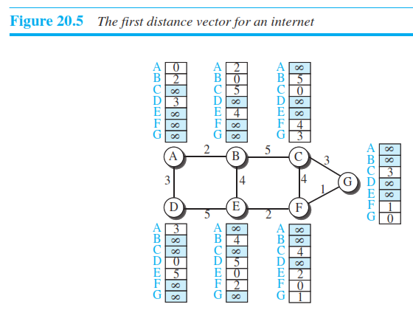
Creating 1st Distance Vector with its Neighbors

Slide 16
Distance Vector Conti……
Do these distance vectors represent least-cost paths?
They do, considering the limited information a node has.
When we know only one distance between two nodes, it is the least cost.
Figure 20.5 shows all nodes first distance vectors for our internet.
However, we need to mention that these vectors are made asynchronously, when the corresponding node has been booted; the existence of all of them in a figure does not mean synchronous creation of them.

Slide 17
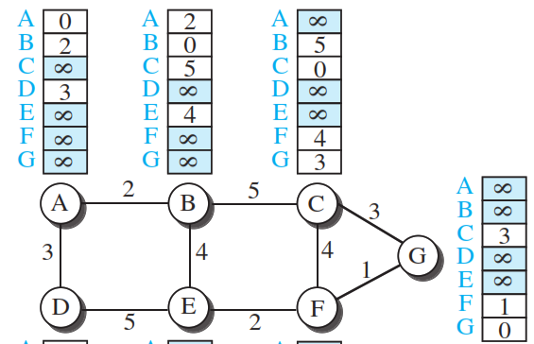
Distance Vector Conti……
These rudimentary vectors cannot help the internet to effectively forward a packet.
For example,
Node A thinks that it is not connected to node G because the corresponding cell shows the least cost of infinity.
To improve these vectors, the nodes in the internet need to help each other by exchanging information.
After each node has created its vector, it sends a copy of the vector to all its immediate neighbors.
After a node receives a distance vector from a neighbor, it updates its distance vector using the Bellman-Ford equation (second case).

Slide 18
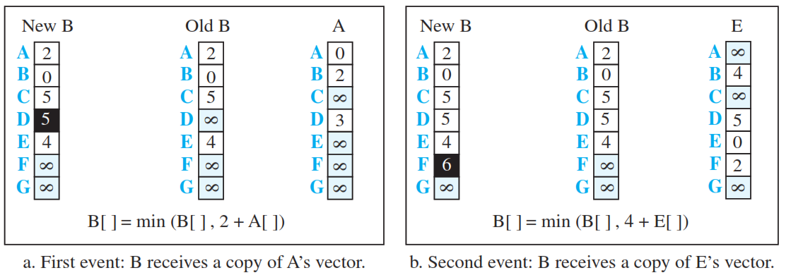
Distance Vector Conti……
However, we need to understand that we need to update, not only one least cost, but N of them in which N is the number of the nodes in the internet.
We can show the whole vector instead of the N separate equations.
We show the whole vector for each update in Figure 20.6.
The figure shows two asynchronous events, happening one after another with some time in between.

Slide 19
Distance Vector Conti……
In the first event, node A has sent its vector to node B.
Node B updates its vector using the cost cBA = 2.
In the second event, node E has sent its vector to node B.
Node B updates its vector using the cost cEA = 4.

Slide 20
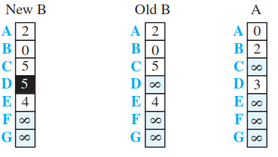
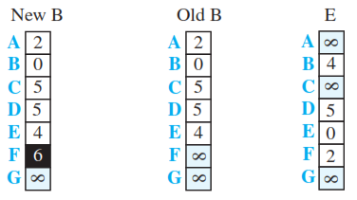
Distance Vector Conti……
After the first event, node B has one improvement in its vector: its least cost to node D has changed from infinity to 5 (via node A).
After the second event, node B has one more improvement in its vector; its least cost to node F has changed from infinity to 6 (via node E).
We hope that we have convinced the reader that exchanging vectors eventually stabilizes the system and allows all nodes to find the ultimate least cost between themselves and any other node.
We need to remember that after updating a node, it immediately sends its updated vector to all neighbors.
Even if its neighbors have received the previous vector, the updated one may help more.

Slide 21
Route Propagation Problems in DV Routers
Count to Infinity
A problem with distance-vector routing is that any decrease in cost (good news) propagates quickly, but any increase in cost (bad news) will propagate slowly.
For a routing protocol to work properly, if a link is broken (cost becomes infinity), every other router should be aware of it immediately
In distance-vector routing, this takes some time. The problem is referred to as count to infinity.
It sometimes takes several updates before the cost for a broken link is recorded as infinity by all routers.

Slide 22
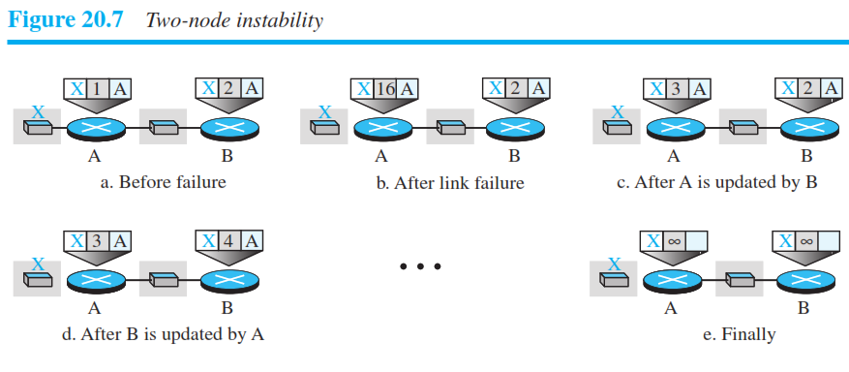
Two-Node Loop
One example of count to infinity is the two-node loop problem.
To understand the problem, let us look at the scenario depicted in Figure 20.7.
The figure shows a system with three nodes.
We have shown only the portions of the forwarding table needed for our discussion.
At the beginning, both nodes A and B know how to reach node X

Slide 23
Two-Node Loop
But suddenly, the link between A and X fails.
Node A changes its table. If A can send its table to B immediately, everything is fine.
However, the system becomes unstable if B sends its forwarding table to A before receiving A’s forwarding table.
Node A receives the update and, assuming that B has found a way to reach X, immediately updates its forwarding table.

Slide 24
Two-Node Loop
Now A sends its new update to B.
Now B thinks that something has been changed around A and updates its forwarding table.
The cost of reaching X increases gradually until it reaches infinity.
At this moment, both A and B know that X cannot be reached.

Slide 25
Two-Node Loop
However, during this time the system is not stable.
Node A thinks that the route to X is via B; node B thinks that the route to X is via A.
If A receives a packet destined for X, the packet goes to B and then comes back to A.
Similarly, if B receives a packet destined for X, it goes to A and comes back to B.
Packets bounce between A and B, creating a two-node loop problem.

Slide 26
Solution to Two Node Problem
A few solutions have been proposed for instability of this kind.
Split Horizon One solution to instability is called split horizon.
In this strategy, instead of flooding the table through each interface, each node sends only part of its table through each interface.
According to this, Node B thinks that the optimum route to reach X is via A, it does not need to advertise this piece of information to A;
As the information has come from A (A already knows).
Taking information from node A, modifying it, and sending it back to node A is what creates the confusion.
In our scenario, node B eliminates the last line of its forwarding table before it sends it to A.
In this case, node A keeps the value of infinity as the distance to X.
Later, when node A sends its forwarding table to B, node B also corrects its forwarding table.
The system becomes stable after the first update: both node A and node B know that X is not reachable.

Slide 27
Poison Reverse
Using the split-horizon strategy has one drawback.
Normally, the corresponding protocol uses a timer, and if there is no news about a route, the node deletes the route from its table.
When node B in Split Horizon eliminates the route to X from its advertisement to A, node A cannot guess whether this is due to the split-horizon strategy (the source of information was A) or because B has not received any news about X recently.
In the poison reverse strategy B can still advertise the value for X, but if the source of information is A, it can replace the distance with infinity as a warning: “Do not use this value; what I know about this route comes from you.”
Three-Node Instability
The two-node instability can be avoided using split horizon combined with poison reverse.
However, if the instability is between three nodes, stability cannot be guaranteed.

Slide 28
20.2.2 Link-State Routing
A routing algorithm that directly follows our discussion for creating least-cost trees and forwarding tables is link-state (LS) routing.
This method uses the term link-state to define the characteristic of a link (an edge) that represents a network in the internet.
In this algorithm the cost associated with an edge defines the state of the link.
Links with lower costs are preferred to links with higher costs;
if the cost of a link is infinity, it means that the link does not exist or has been broken.

Slide 29
Link-State Database (LSDB)
To create a least-cost tree with this method, each node needs to have a complete map of the network, which means it needs to know the state of each link.
The collection of states for all links is called the link-state database (LSDB).
There is only one LSDB for the whole internet; each node needs to have a duplicate of it to be able to create the least-cost tree.
Figure 20.8 shows an example of an LSDB for the graph in Figure 20.1.
The LSDB can be represented as a two-dimensional array(matrix) in which the value of each cell defines the cost of the corresponding link.

Slide 30
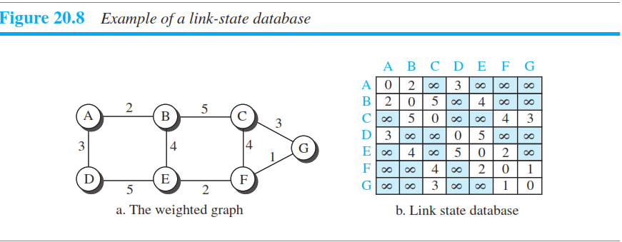
Link-State Database (LSDB)

Slide 31
Link-State Database (LSDB)
Now the question is how each node can create this LSDB that contains information about the whole internet.
This can be done by a process called flooding.
Each node can send some greeting messages to all its immediate neighbors (those nodes to which it is connected directly)
To collect two pieces of information for each neighboring node:
the identity of the node and
the cost of the link.
The combination of these two pieces of information is called the LS packet (LSP);

Slide 32
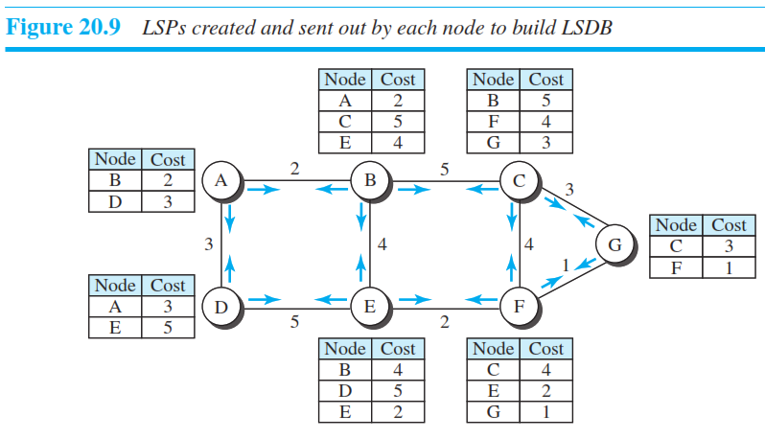
The LSP is sent out of each interface, as shown in Figure 20.9 for our internet in Figure 20.1.
When a node receives an LSP from one of its interfaces,
it compares the LSP with the copy it may already have.
If the newly arrived LSP is older than the one it has (found by checking the sequence number), it discards the LSP.
If it is newer or the first one received, the node discards the old LSP (if there is one) and keeps the received one.

Slide 33
It then sends a copy of it out of each interface except the one from which the packet arrived.
This guarantees that flooding stops somewhere in the network (where a node has only one interface).
We need to convince ourselves that, after receiving all new LSPs, each node creates the comprehensive LSDB as shown in Figure 20.9.
This LSDB is the same for each node and shows the whole map of the internet.
In other words, a node can make the whole map if it needs to, using this LSDB

Slide 34
Comparing DV with LS
We can compare the link-state routing algorithm with the distance-vector routing algorithm.
In the distance-vector routing algorithm,
Each router tells its neighbors what it knows about the whole internet;
In the link-state routing algorithm,
each router tells the whole internet what it knows about its neighbors.

Slide 35
Formation of Least-Cost Trees
To create a least-cost tree for itself, using the shared LSDB, each node needs to run the famous Dijkstra Algorithm.
This iterative algorithm uses the following steps:
1. The node chooses itself as the root of the tree, creating a tree with a single node, and sets the total cost of each node based on the information in the LSDB.
2. The node selects one node, among all nodes not in the tree, which is closest to the root, and adds this to the tree. After this node is added to the tree, the cost of all other nodes not in the tree needs to be updated because the paths may have been changed.
3. The node repeats step 2 until all nodes are added to the tree.
We need to convince ourselves that the above three steps finally create the least-cost tree.

Slide 36
20.3 UNICAST ROUTING PROTOCOLS
Previously we discussed unicast routing algorithms;
Now, we discuss unicast routing protocols used in the Internet.
Although three protocols we discuss here are based on the corresponding algorithms we discussed before, a protocol is more than an algorithm.
A protocol needs to define its domain of operation, the messages exchanged, communication between routers, and interaction with protocols in other domains.
After an introduction, we discuss three common protocols used in the Internet:
Routing Information Protocol (RIP), based on the distance-vector algorithm,
Open Shortest Path First (OSPF), based on the link-state algorithm, and

Slide 37
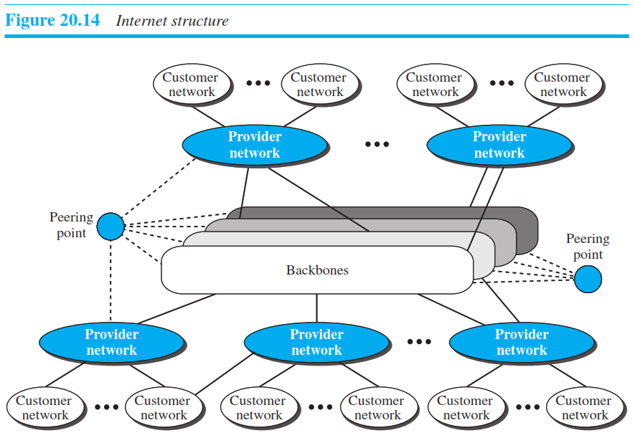
20.3.1 Internet Structure
First, we need to understand the structure of today’s Internet.
The Internet has changed from a tree-like structure, with a single backbone, to a multi-backbone structure run by different private corporations today.
Although it is difficult to give a general view of the Internet today, we can say that the Internet has a structure similar to what is shown in Figure 20.14.

Slide 38
20.3.2 Routing Information Protocol (RIP)
The Routing Information Protocol (RIP) is one of the most widely used intradomain routing protocols based on the distance-vector routing algorithm we described earlier.
Hop Count
A router in this protocol basically implements the distance-vector routing algorithm.
However, the algorithm has been modified as:
First, since a router in an AS needs to know how to forward a packet to different networks (subnets) in an AS, RIP routers advertise the cost of reaching different networks instead of reaching other nodes in a theoretical graph.
In other words, the cost is defined between a router and the network in which the destination host is located.
Second, to make the implementation of the cost simpler (independent from performance factors of the routers and links, such as delay, bandwidth, and so on), the cost is defined as the number of hops,
Meaning the number of networks (subnets) a packet needs to travel through from the source router to the final destination host.
Note that the network in which the source host is connected is not counted in this calculation because the source host does not use a forwarding table; the packet is delivered to the default router.

Slide 39
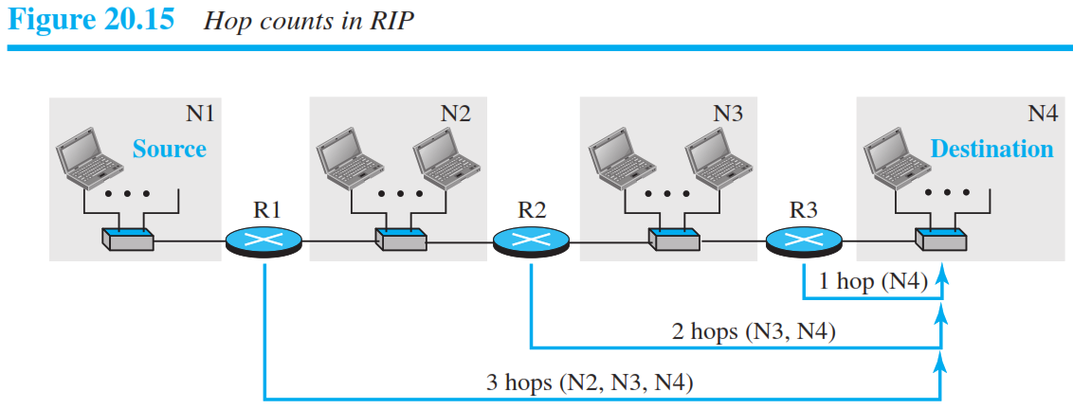
Hop Count in RIP
Figure 20.15 shows the concept of hop count advertised by three routers from a source host to a destination host.
In RIP, the maximum cost of a path can be 15, which means 16 is considered as infinity (no connection).
For this reason, RIP can be used only in autonomous systems in which the diameter of the AS is not more than 15 hops.

Slide 40
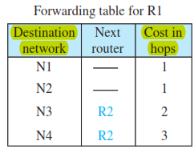
Forwarding Tables
The distance-vector algorithm is concerned with exchanging distance vectors between neighboring nodes,
the routers in an autonomous system (AS) need to keep forwarding tables to forward packets to their destination networks.
A forwarding table in RIP is a three-column table
the first column is the address of the destination network,
the second column is the address of the next router to which the packet should be forwarded, and
the third column is the cost (the number of hops) to reach the destination network.

Slide 41
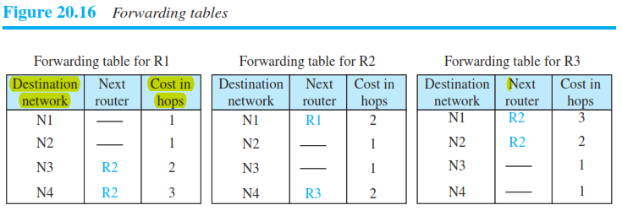
Forwarding Tables
Figure 20.16 shows the three forwarding tables for the routers in Figure 20.15.
Note that the first and the third columns together convey the same information as does a distance vector, But the cost shows the number of hops to the destination networks.

Slide 42
Forwarding Tables
Although a forwarding table in RIP defines only the next router in the second column,
it gives the information about the whole least-cost tree based on the second property of these trees.
For example,
R1 defines that the next router for the path to N4 is R2;
R2 defines that the next router to N4 is R3;
R3 defines that there is no next router for this path.
The tree is then R1 → R2 → R3 → N4.
A question often asked about the forwarding table is
?what the use of the third column is.
The third column is not needed for forwarding the packet, but it is needed for updating the forwarding table when there is a change in the route, as we will see shortly.

Slide 43
RIP Implementation
RIP is implemented as a process that uses the service of UDP on the well-known port number 520.
This means that, although RIP is a routing protocol to help IP route its datagrams through the AS,
the RIP messages are encapsulated inside UDP user datagrams,
which in turn are encapsulated inside IP datagrams.
In other words, RIP runs at the application layer, but creates forwarding tables for IP at the network later.
RIP has gone through two versions: RIP-1 and RIP-2.
The version 2 is backward compatible with the first.
We discuss only RIP-2 in this section.

Slide 44
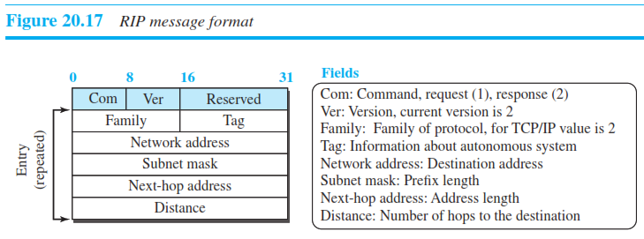
RIP Messages
Two RIP processes, a client and a server,
like any other processes, need to exchange messages.
RIP-2 defines the format of the message, as shown in Figure 20.17.
Part of the message, which we call entry, can be repeated as needed in a message.
Each entry carries the information related to one line in the forwarding table of the router that sends the message.

Slide 45
RIP Messages
RIP has two types of messages: request and response.
A request message is sent by a router that has just come up or by a router that has some time-out entries.
A request message can ask about specific entries or all entries.
A response (or update) message can be either solicited or unsolicited.
A solicited response message is sent only in answer to a request message.
It contains information about the destination specified in the corresponding request message.
An unsolicited response message, on the other hand, is sent periodically, every 30 seconds or when there is a change in the forwarding table.

Slide 46
RIP Algorithm
RIP implements the same algorithm as the distance-vector routing algorithm
However, some changes need to be made to the algorithm to enable a router to update its forwarding table:
1. If the received route does not exist in the old forwarding table, it should be added to the route.
2. If the cost of the received route is lower than the cost of the old one, the received route should be selected as the new one.
3. If the cost of the received route is higher than the cost of the old one, but the value of the next router is the same in both routes, the received route should be selected as the new one. This is the case where the route was actually advertised by the same router in the past, but now the situation has been changed.
For example,
suppose a neighbor has previously advertised a route to a destination with cost 3, but now there is no path between this neighbor and that destination. The neighbor advertises this destination with cost value infinity (16 in RIP). The receiving router must not ignore this value even though its old route has a lower cost to the same destination.

Slide 47
Timers in RIP
RIP uses three timers to support its operation.
The periodic timer controls the advertising of regular update messages.
Each router has one periodic timer that is randomly set to a number between 25 and 35 seconds
(to prevent all routers sending their messages at the same time and creating excess traffic).
The timer counts down; when zero is reached,
the update message is sent, and the timer is randomly set once again.
The expiration timer governs the validity of a route.
When a router receives update information for a route, the expiration timer is set to 180 seconds for that particular route.
Every time a new update for the route is received,
the timer is reset.
If there is a problem on an internet and no update is received within the allotted 180 seconds,
the route is considered expired and the hop count of the route is set to 16, which means the destination is unreachable.
Every route has its own expiration timer.

Slide 48
Timers in RIP
The garbage collection timer is used to purge a route from the forwarding table.
When the information about a route becomes invalid, the router does not immediately purge that route from its table.
Instead, it continues to advertise the route with a metric value of 16.
At the same time, a garbage collection timer is set to 120 seconds for that route.
When the count reaches zero, the route is purged from the table.
This timer allows neighbors to become aware of the invalidity of a route prior to purging.

Slide 49
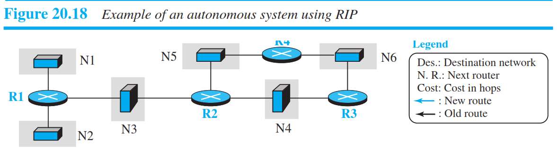
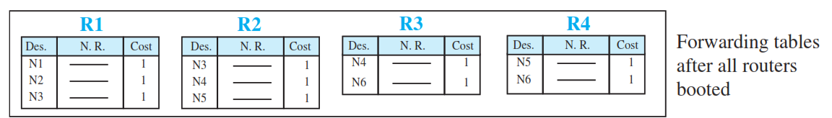
Example 20.1
Figure 20.18 shows a more realistic example of the operation of RIP in an autonomous system.

Slide 50
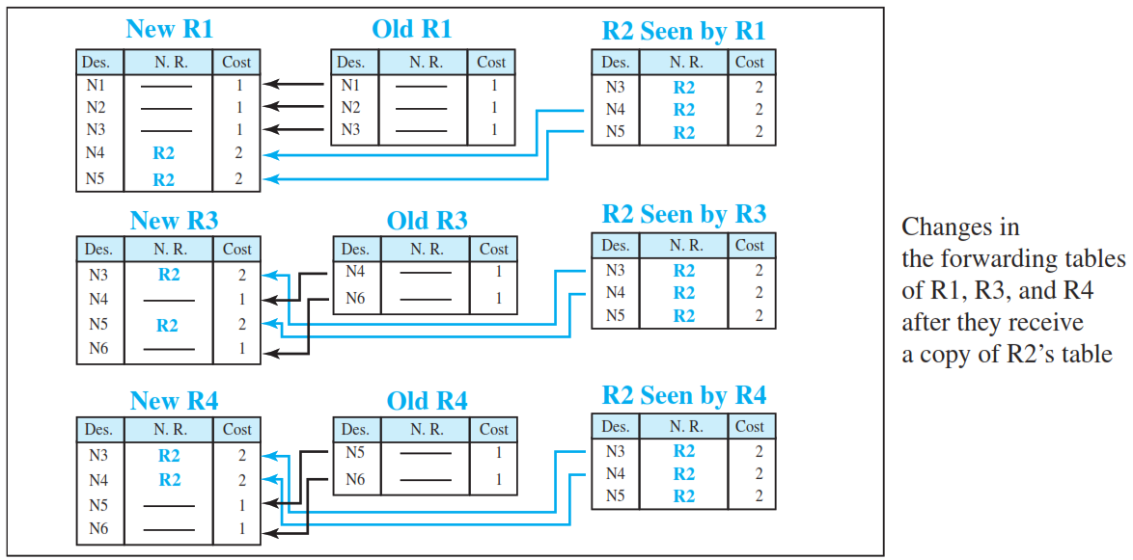
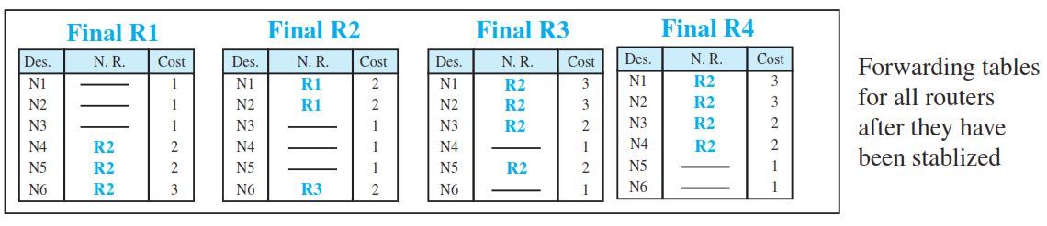

Slide 51
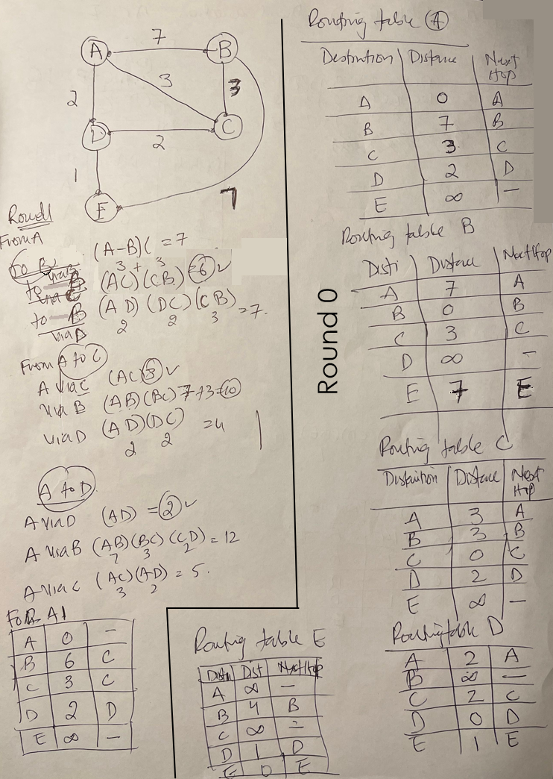
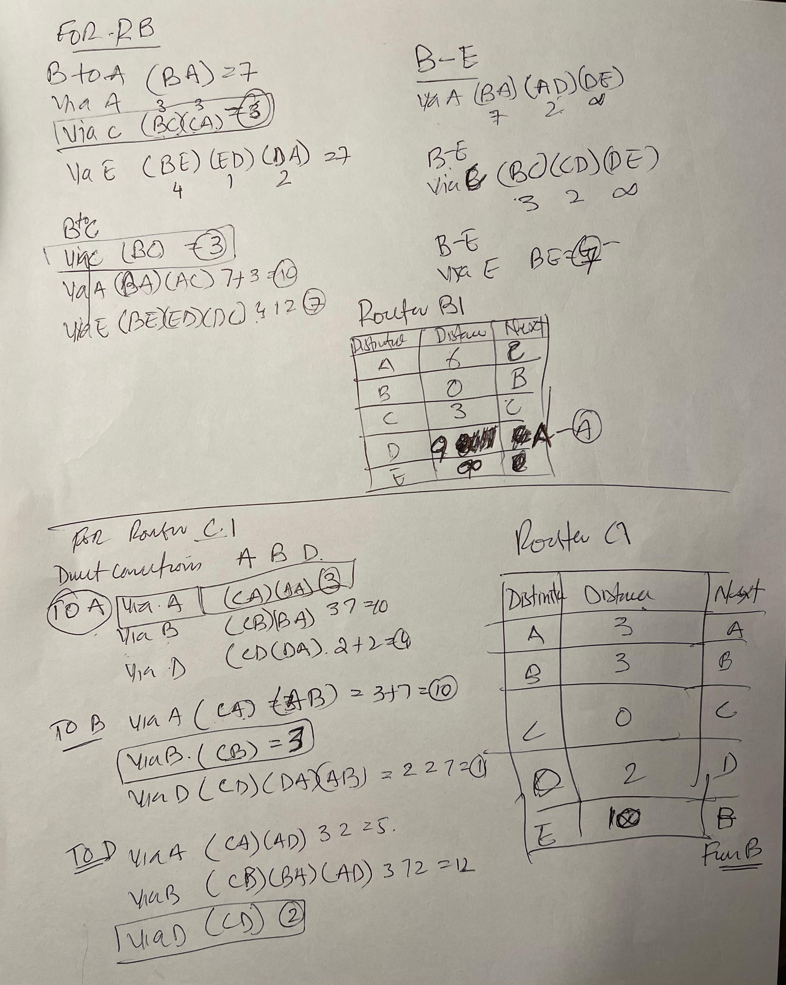

Slide 52
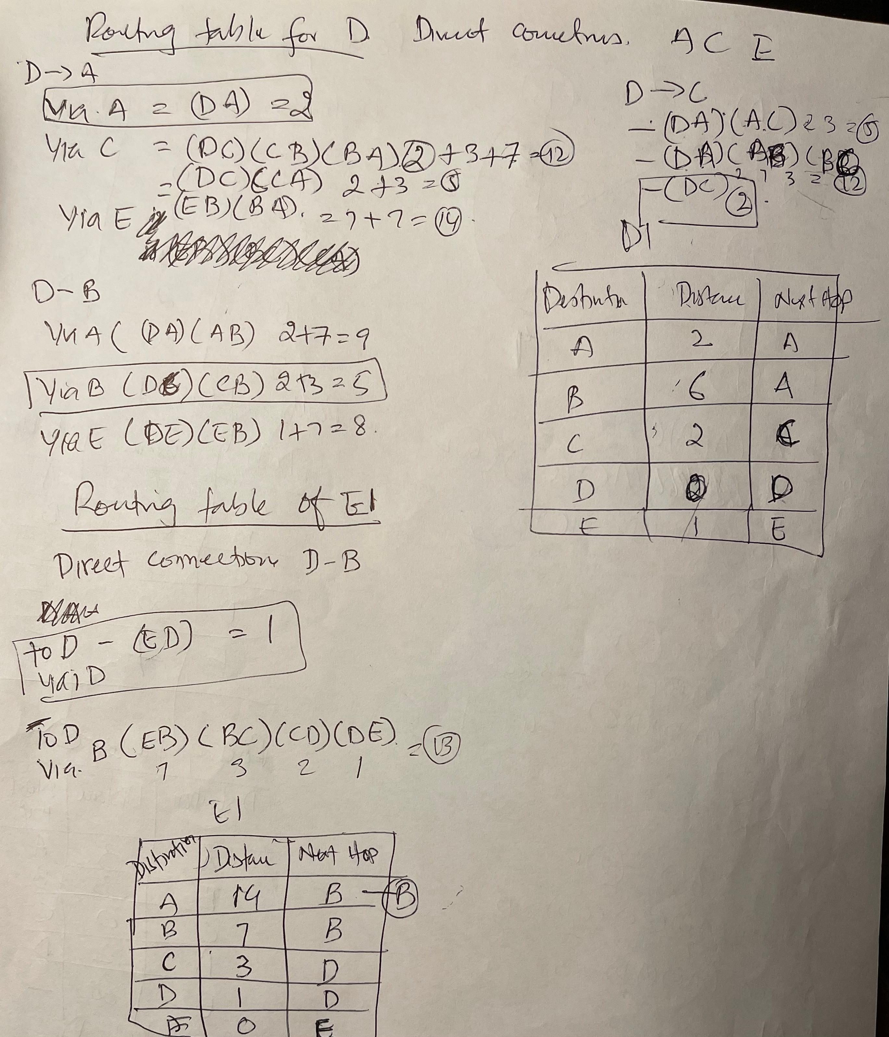
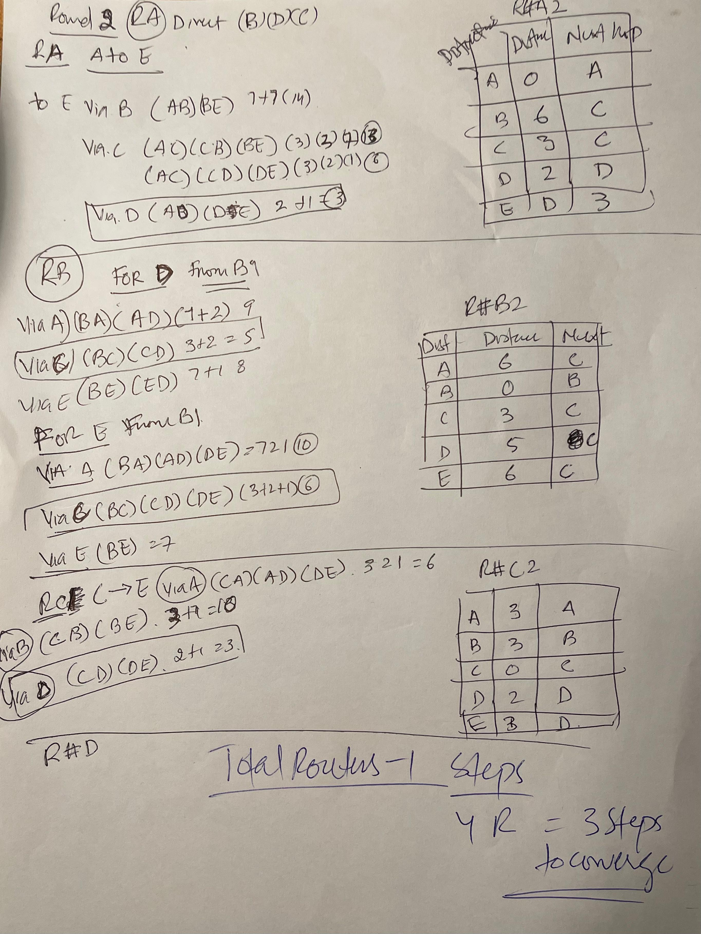
v

